Slide 1
Thesis Report: UNDERWATER IMAGE ENHANCEMENT USING IMAGE PROCESSING
Yugansh Jain • 184506
Under Supervision of : Dr. Gagnesh Kumar

Slide 2
Introduction
- Image enhancement is the major process in the image processing techniques. Image enhancement would increase the sharpness and intensity of the underwater images. By increasing the factors of the pixels, the object can be visible clearly in the underwater images. It is the process of improving the quality of image without any information loss. Usually the images are affected by various facts. Especially in underwater imagery, the haze and hue variations are greatly affected. Our work discusses the issues in underwater images and compares the existing image enhancement techniques for underwater images
Notes:
Image enhancement is the process of improving the quality of the input image so that it would be easily understood by viewers in the future. Image enhancement improves the information content of the image and alters the visual impact of the image on the observer. Image enhancement intensifies the features of images. It accentuates the image features like edges, contrast to build display of photographs more useful for examination and study. Image enhancement includes many operations such as contrast stretching, noise clipping, pseudocoloring, noise filtering etc to improve the view of images. Active range of the chosen features of images is amplified by enhancement so that they can be detected simply. Underwater images mainly suffer from the problem of poor color contrast and poor visibility. These problems occurred due to the scattering of light and refraction of light while entering from rarer to denser medium. Scattering causes the blurring of light and reduces the color contrast. These effects of water on underwater images are only not due the nature water but also because of the organisms and other material present in the water. Many techniques and methods are established by researchers to solve the problem of underwater image enhancement. In this paper different underwater image enhancing techniques are reviewed and studied. The overall objective is to explore the shortcomings in earlier techniques.

Slide 3
Progress - Literature survey (1)
"Color Balance and Fusion for Underwater Image Enhancement" by Codruta O. Ancuti, Cosmin Ancuti, Christophe De Vleeschouwer, and Philippe Bekaert, published in the journal "The authors propose an algorithm that combines color balance and fusion methods to address the challenges associated with underwater imaging, such as color distortion and low contrast. The color balance technique aims to restore the colors of underwater images by adapting the color distribution of the captured image to a reference color distribution.
Underwater Image Enhancement Using Adaptive CLAHE in HSV Color Space" by A. Kumar, R. Singh, S. Jain, and A. Khanna (2022) In this paper, Kumar et al. propose an underwater image enhancement technique using adaptive CLAHE in the HSV color space. The authors leverage the inherent properties of the HSV color model, where the value component represents the image intensity information. By applying adaptive CLAHE to the value component, the algorithm enhances the contrast and visibility of underwater images. Experimental results demonstrate that the proposed method effectively enhances the quality of underwater images compared to conventional CLAHE techniques.
Notes:
Review of "Color Balance and Fusion for Underwater Image Enhancement": Ancuti et al. present a comprehensive study on color balance and fusion techniques for underwater image enhancement. The authors propose an algorithm that combines color balance and fusion methods to address the challenges associated with underwater imaging, such as color distortion and low contrast. The color balance technique aims to restore the colors of underwater images by adapting the color distribution of the captured image to a reference color distribution. The fusion technique integrates multiple versions of the image obtained using different color balance settings to produce a final enhanced image. The experiments conducted by the authors demonstrate that their approach effectively improves the visual quality of underwater images, enhancing color fidelity and overall image appearance.

Slide 4
Literature survey (2)
"Underwater Image Enhancement Based on RGB-CLAHE and Color Correction in RGB Space" by L. Zhang, Y. Zhang, and X. Zhou (2021) Zhang et al. present an underwater image enhancement approach based on RGB-CLAHE and color correction in the RGB color space. The authors first apply CLAHE independently to the three RGB channels to improve contrast and enhance details. Additionally, a color correction technique is employed to compensate for color distortion caused by the underwater environment. Experimental evaluations demonstrate that the proposed method effectively enhances underwater images, preserving natural colors and improving visual quality.
"Underwater Image Enhancement Based on CLAHE in Lab Color Space with Fusion Strategy" by J. Chen, X. Wu, and H. Zhang (2023) Chen et al. propose an underwater image enhancement method based on CLAHE in the Lab color space with a fusion strategy. The authors utilize the Lab color space, which separates the luminance (L) and chrominance (a and b) information. CLAHE is applied to the L channel to enhance contrast and details, while the a and b channels are adjusted to improve color rendering. The fusion strategy combines the enhanced channels to produce the final enhanced image. Experimental results demonstrate that the proposed method effectively enhances underwater images, providing improved contrast, color accuracy, and overall visual quality.

Slide 5
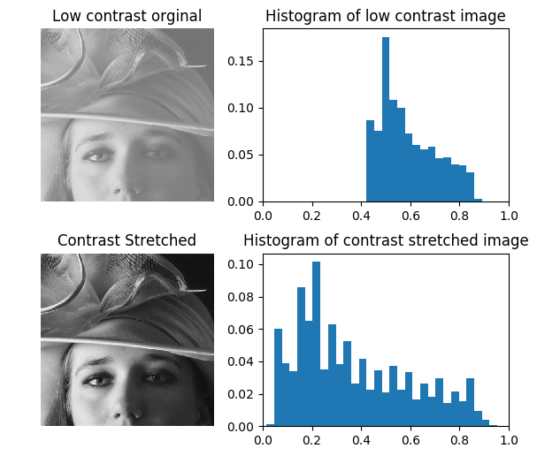
DIFFERENT TECHNIQUES FOR UNDERWATER IMAGE ENHANCEMENT -1
Contrast stretching : Contrast stretching is a straightforward image enhancement method that is used to improve, enhance the image contrast by `stretching' the series of intensity values. A measure of image’s dynamic range or the "broaden" of image’s histogram is the contrast of an image.
Notes:
Contrast stretching (often called normalization) is a simple image enhancement technique that attempts to improve the contrast in an image by `stretching' the range of intensity values it contains to span a desired range of values, e.g. the the full range of pixel values that the image type concerned allows. It differs from the more sophisticated histogram equalization in that it can only apply a linear scaling function to the image pixel values. As a result the `enhancement' is less harsh. (Most implementations accept a graylevel image as input and produce another graylevel image as output.)

Slide 6
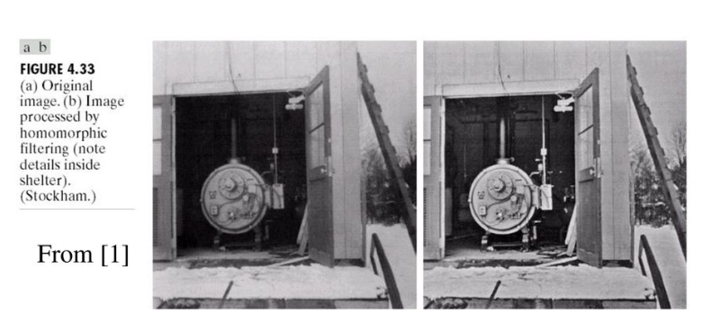
DIFFERENT TECHNIQUES FOR UNDERWATER IMAGE ENHANCEMENT -2
Homomorphic filtering : The homomorphic filtering is utilized to fix non-uniform lighting to reinforce contrast from the impression. This is a frequency filtering technique. It is the most utilized system on the grounds that it redresses non-uniform lighting and sharpens the picture.

Slide 7
DIFFERENT TECHNIQUES FOR UNDERWATER IMAGE ENHANCEMENT-3
Histogram equalization : Histogram equalization is a method for modifying image intensities and contrast of image in image processing using the image's histogram. Histogram equalization is helpful in pictures with backgrounds and frontal areas that are both bright or both dim. This is a simple and straightforward technique.
Contrast Limited Adaptive Histogram Equalization (CLAHE) It is generalization of adaptive histogram equalization. With this technique the image is broken up into tiles. The gray scale is calculated for each of these tiles, based upon its histogram and transform function, which is derived from the interpolation between the manipulated histograms of the neighboring sub-regions.

Slide 8
CLAHE :
Adaptive histogram equalization (AHE) is a computer image processing technique used to improve contrast in images. It differs from ordinary histogram equalization in the respect that the adaptive method computes several histograms, each corresponding to a distinct section of the image, and uses them to redistribute the lightness values of the image. It is therefore suitable for improving the local contrast .
However, AHE has a tendency to over amplify noise in relatively homogeneous regions of an image. A variant of adaptive histogram equalization called contrast limited adaptive histogram equalization (CLAHE) prevents this by limiting the amplification

Slide 9
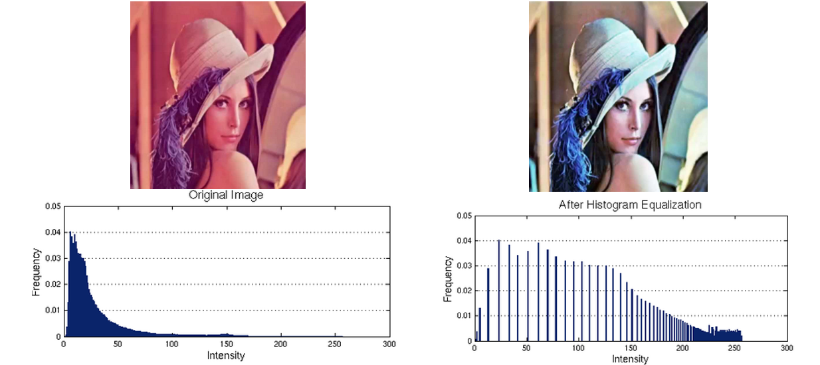
Experimental results of CLAHE :

Slide 10
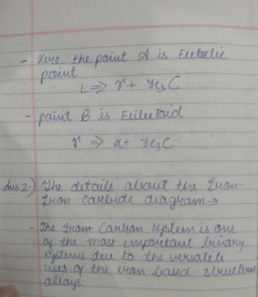
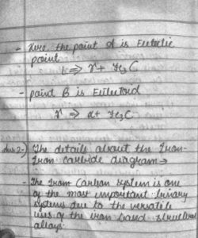
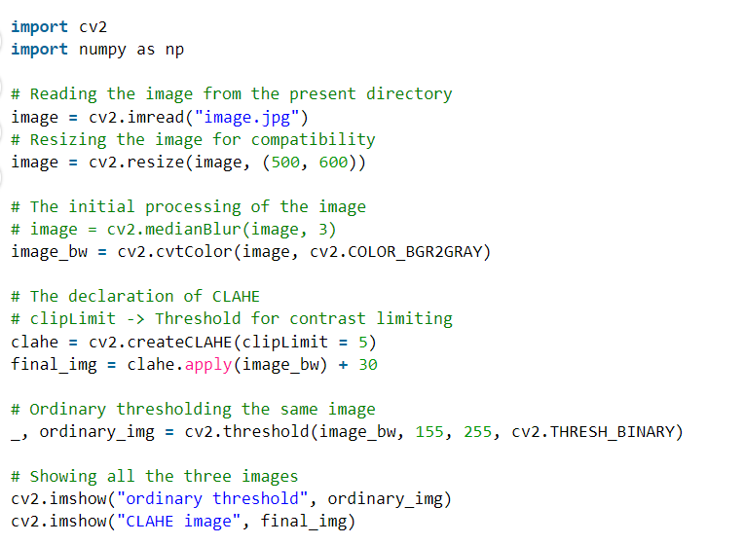
CLAHE Histogram Equalization : CLAHE operates on small regions in the image, called tiles, rather than the entire image. The neighboring tiles are then combined using bilinear interpolation to remove the artificial boundaries.

Slide 11
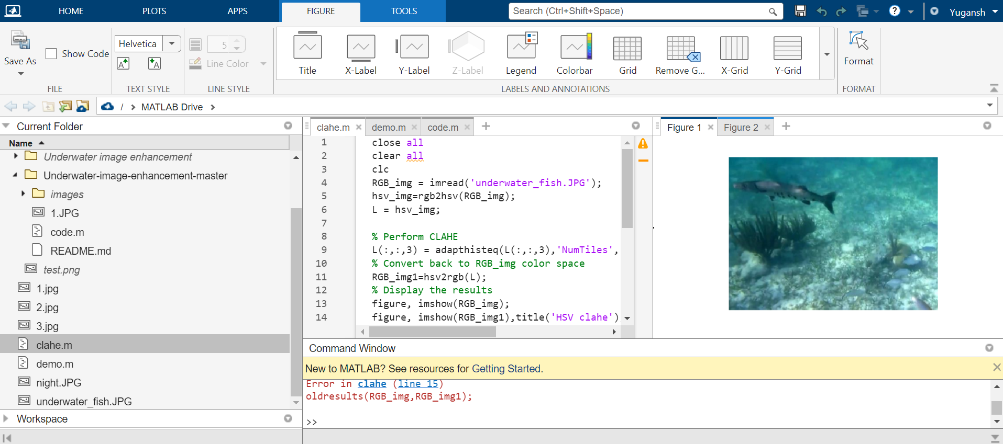
Performing CLAHE :

Slide 12
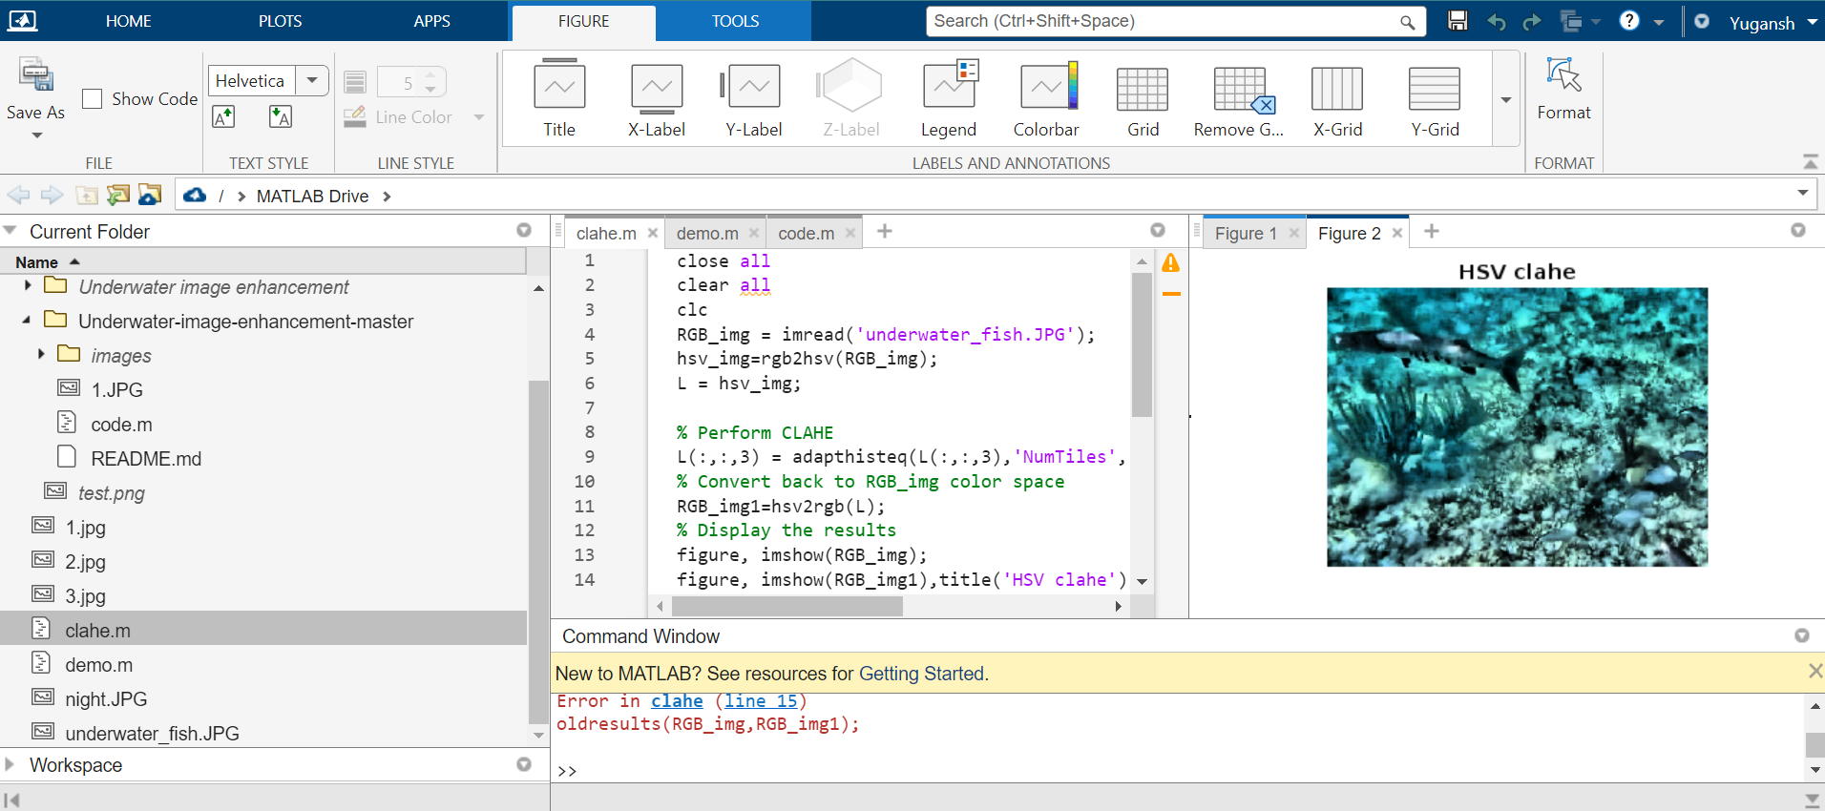

Slide 13
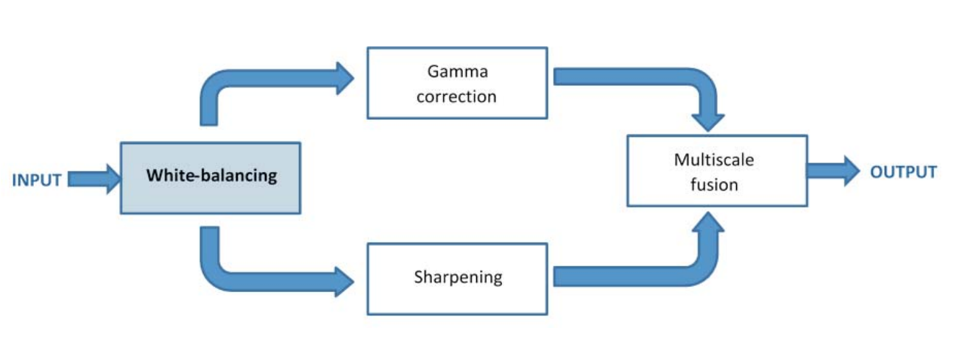
This method is a single image approach that does not require specialized hardware or knowledge about the underwater conditions or scene structure. It builds on the blending of two images that are directly derived from a color-compensated and white-balanced version of the original degraded image.
Notes:
In our approach, white balancing aims at compensating for the color cast caused by the selective absorption of colors with depth, while image fusion is considered to enhance the edges and details of the scene, to mitigate the loss of contrast resulting from backscattering. White-balancing aims at improving the image aspect, primarily by removing the undesired color castings due to various illumination or medium attenuation properties.

Slide 14
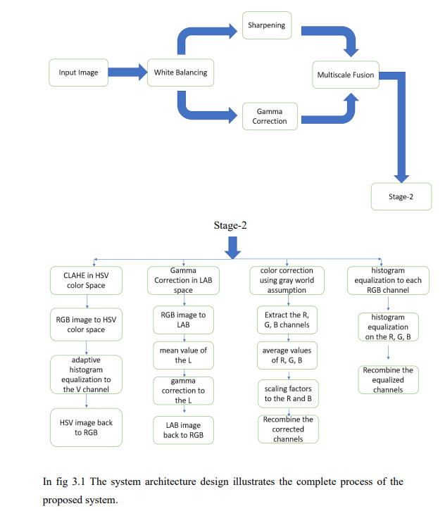
Notes:
In our approach, white balancing aims at compensating for the color cast caused by the selective absorption of colors with depth, while image fusion is considered to enhance the edges and details of the scene, to mitigate the loss of contrast resulting from backscattering. White-balancing aims at improving the image aspect, primarily by removing the undesired color castings due to various illumination or medium attenuation properties.

Slide 15
A novel approach to remove the haze in underwater images based on a single image captured with a conventional camera.
Our approach builds on the fusion of multiple inputs.
The white balancing stage aims at removing the color cast induced by underwater light scattering, so as to produce a natural appearance of the sub-sea images.
The two images to fusion, as well as their associated weight maps, are defined to promote the transfer of edges and color contrast to the output image.

Slide 16
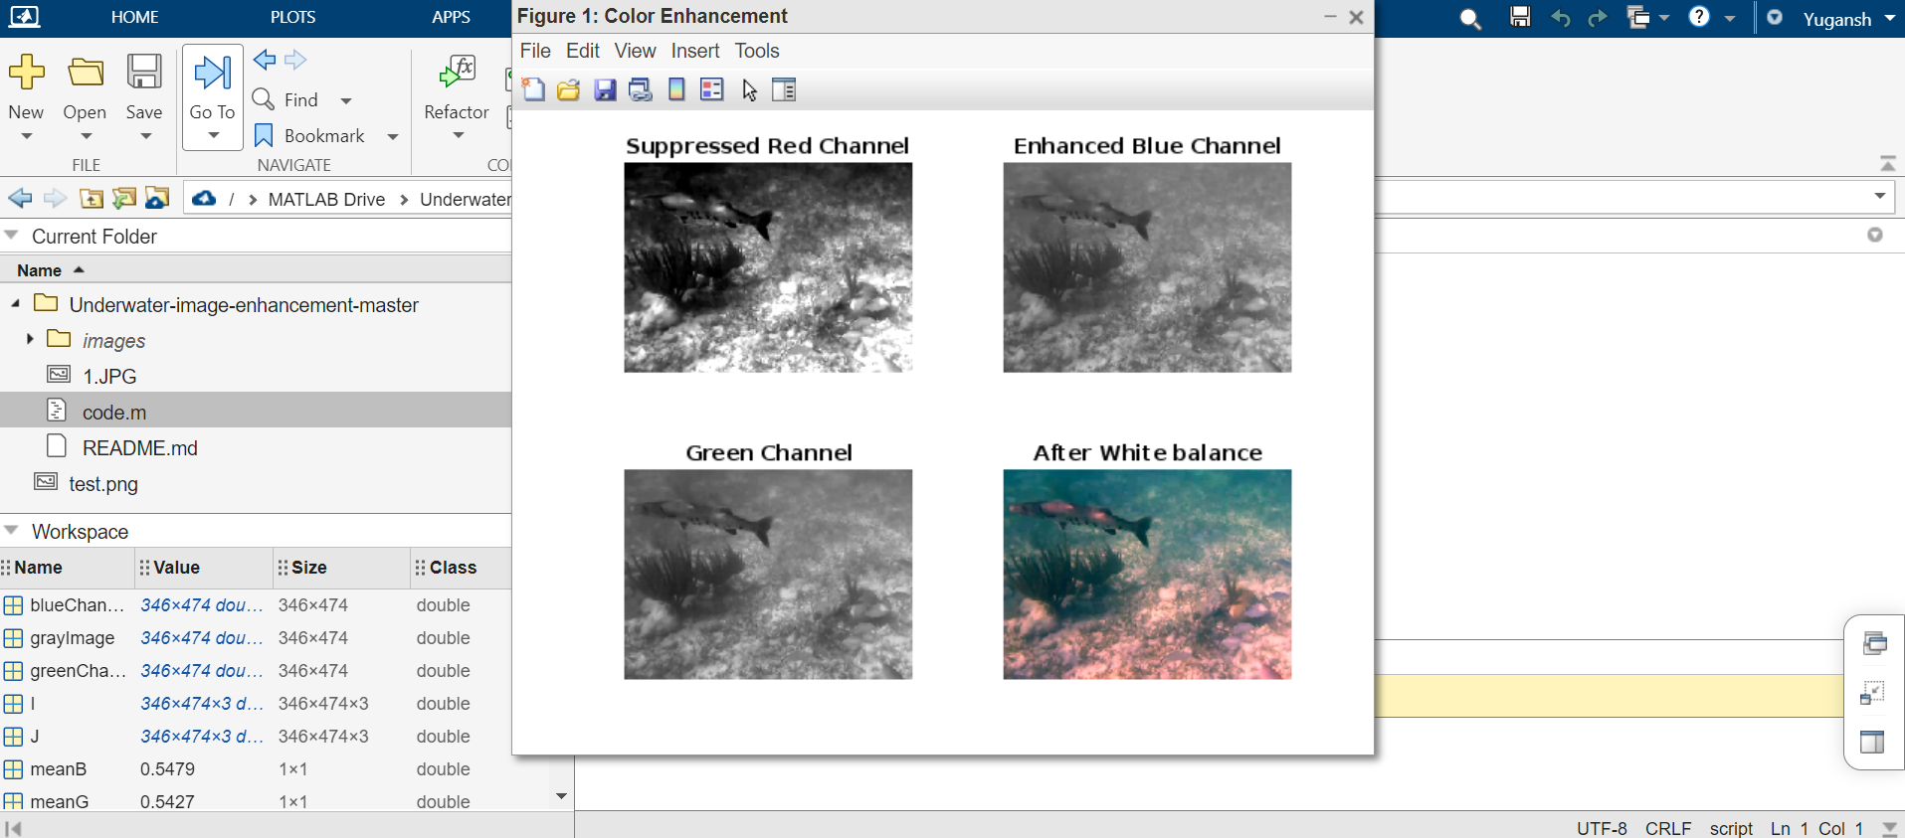

Slide 17
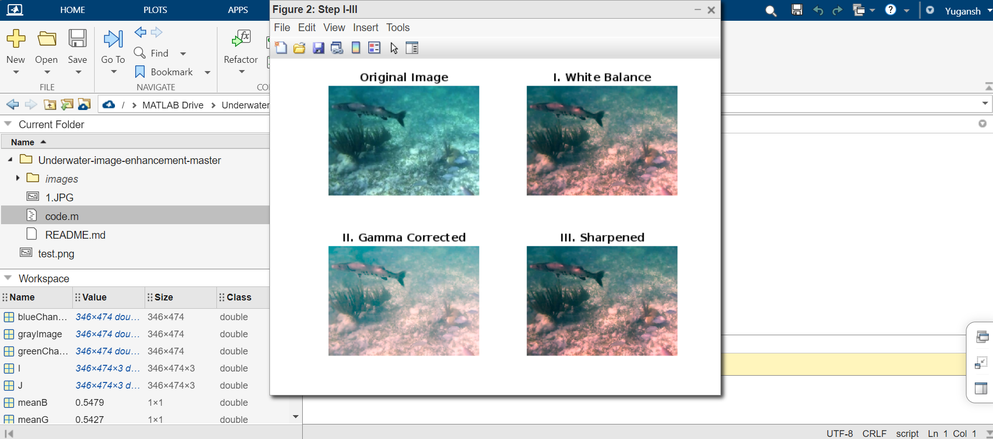

Slide 18
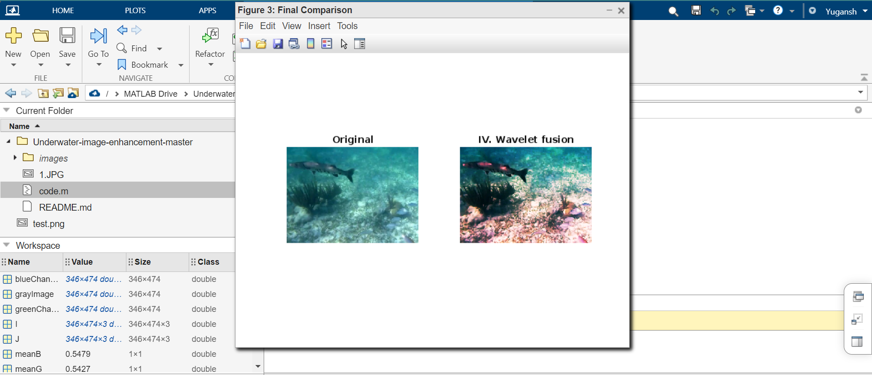

Slide 19
Gaps in Literature :
Nowadays image enhancement algorithms are very much popular, helpful and valuable for many image based applications. It has been originated that the majority of the current examination have mistreated various points.
Below mentioned are the different research gaps accomplished from the literature survey:-
1. The presented strategies have ignored the methods to lessen the noise issue, which is available in the resultant pictures of the current image improvement procedures.
2. Much effort has not paid attention on L*A*B color space.
3. The issue of the uneven light illumination is likewise disregarded by the vast majority of the scientists.

Slide 20
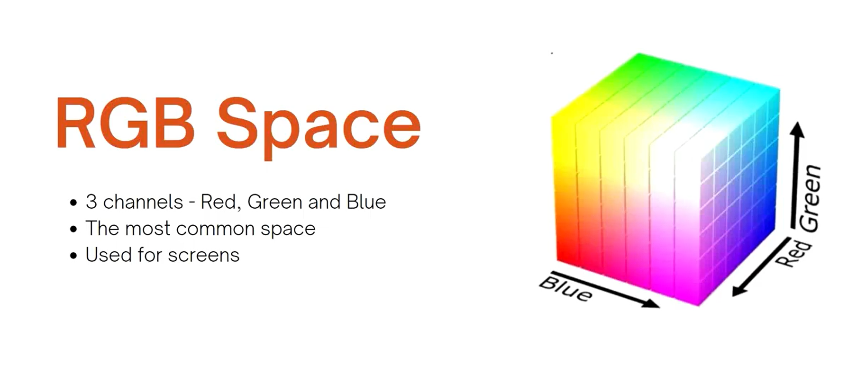

Slide 21
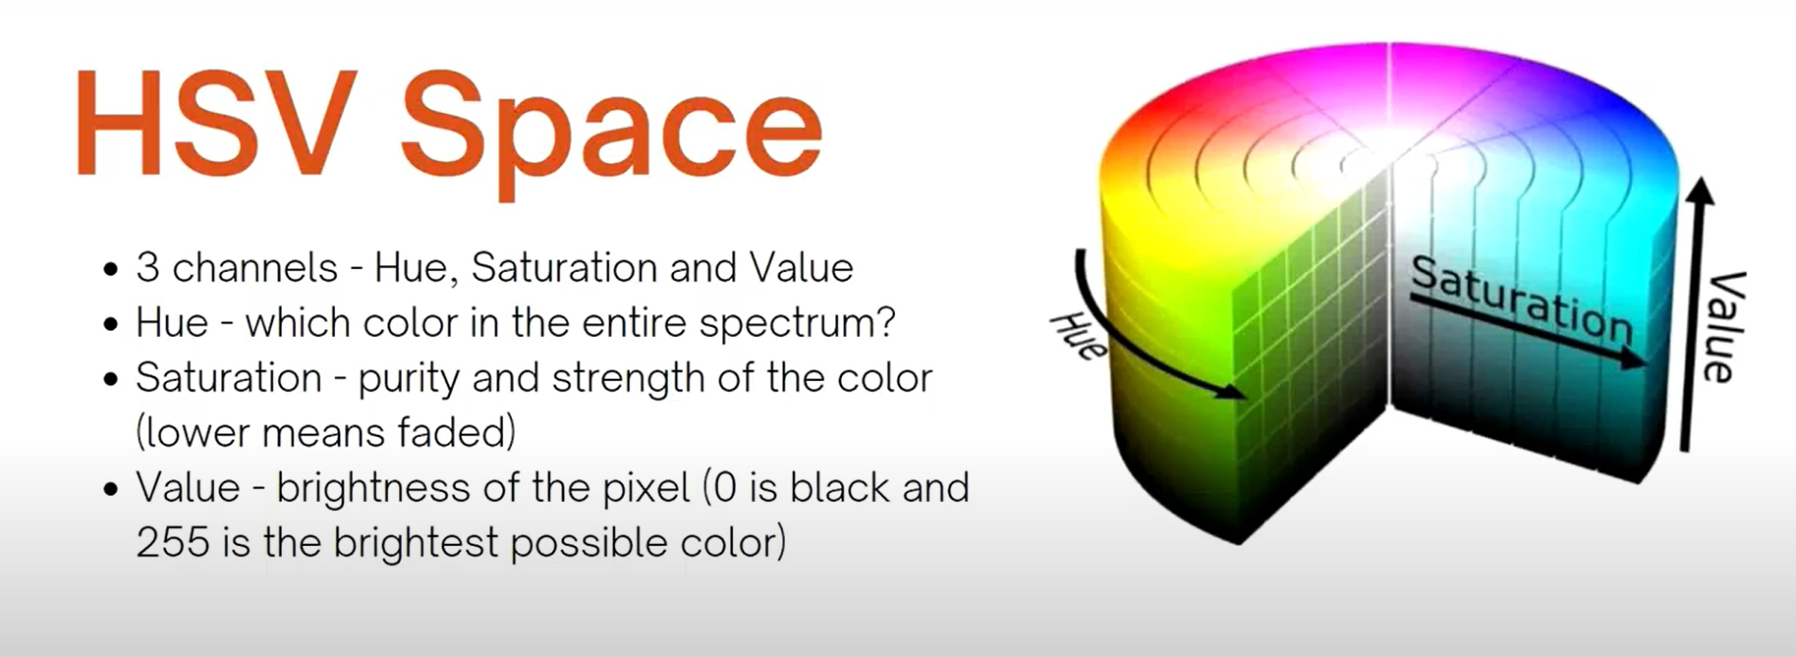

Slide 22
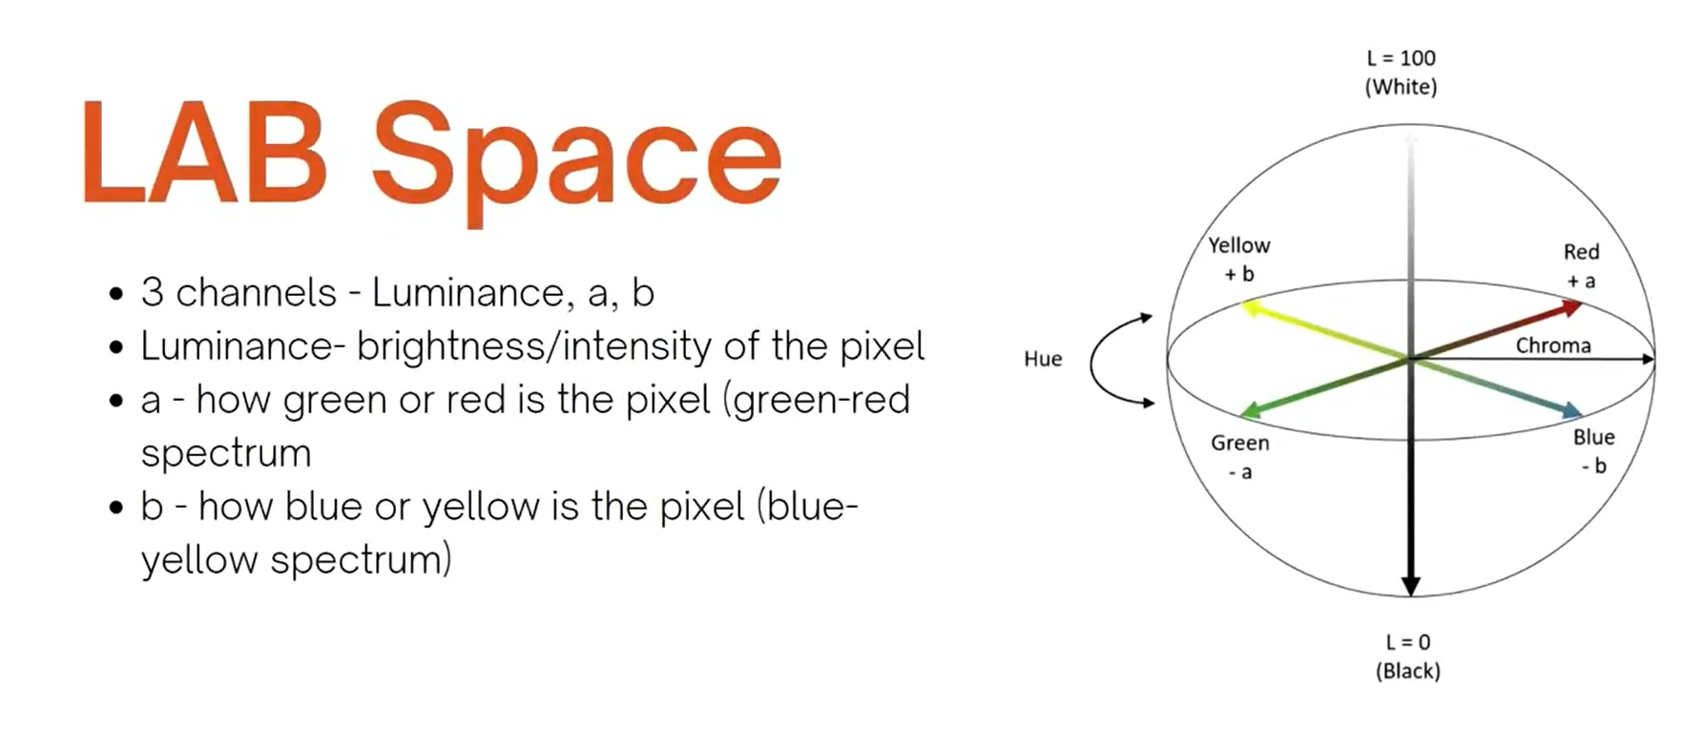

Slide 23
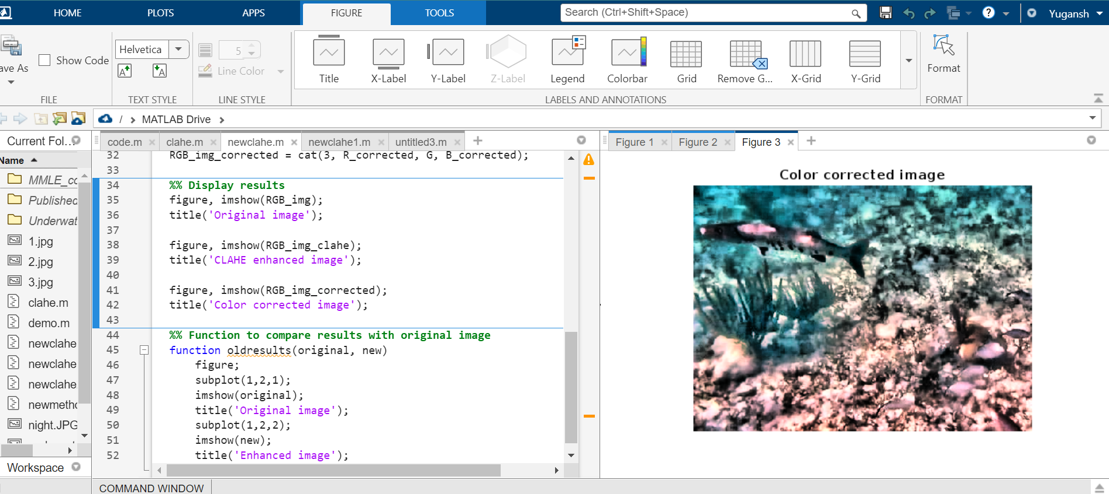
1. To further enhance underwater images, we can apply a method called color correction. Underwater images tend to have a blue or green tint due to the absorption and scattering of light by water. Color correction can help to restore the natural colors in the image.

Slide 24
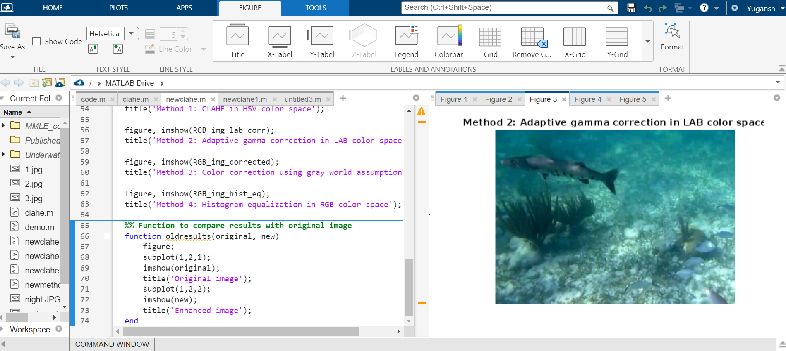
2. Different methods for underwater image enhancement:

Slide 25
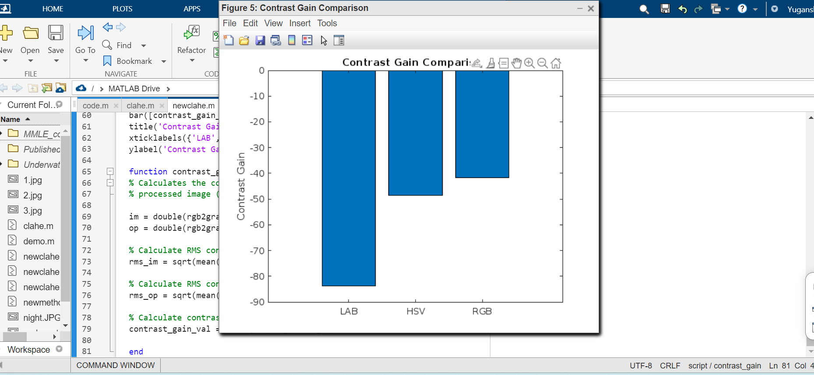
3. CLAHE on LAB, HSV, and RGB color spaces, and calculates the contrast gain between the original and processed images. The contrast gain values are plotted in a bar graph for comparison.

Slide 26
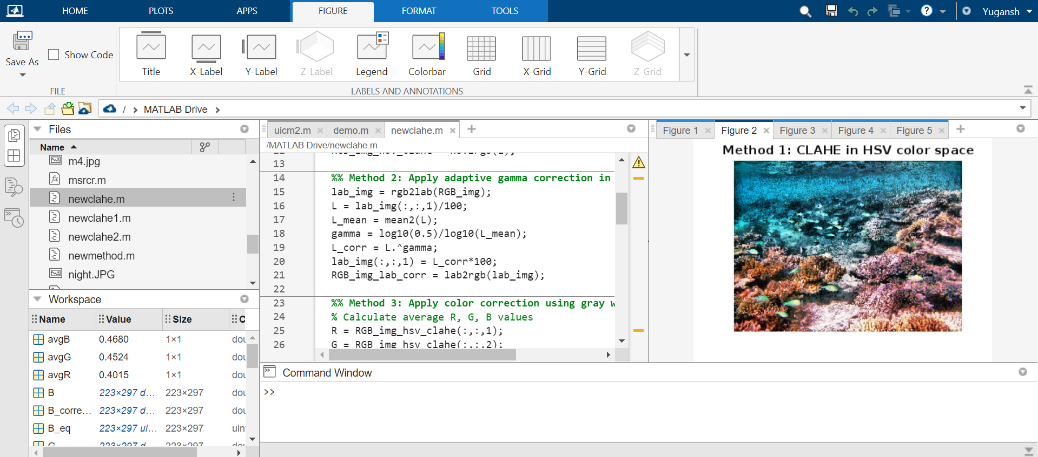
Method 1: CLAHE in HSV color space

Slide 27
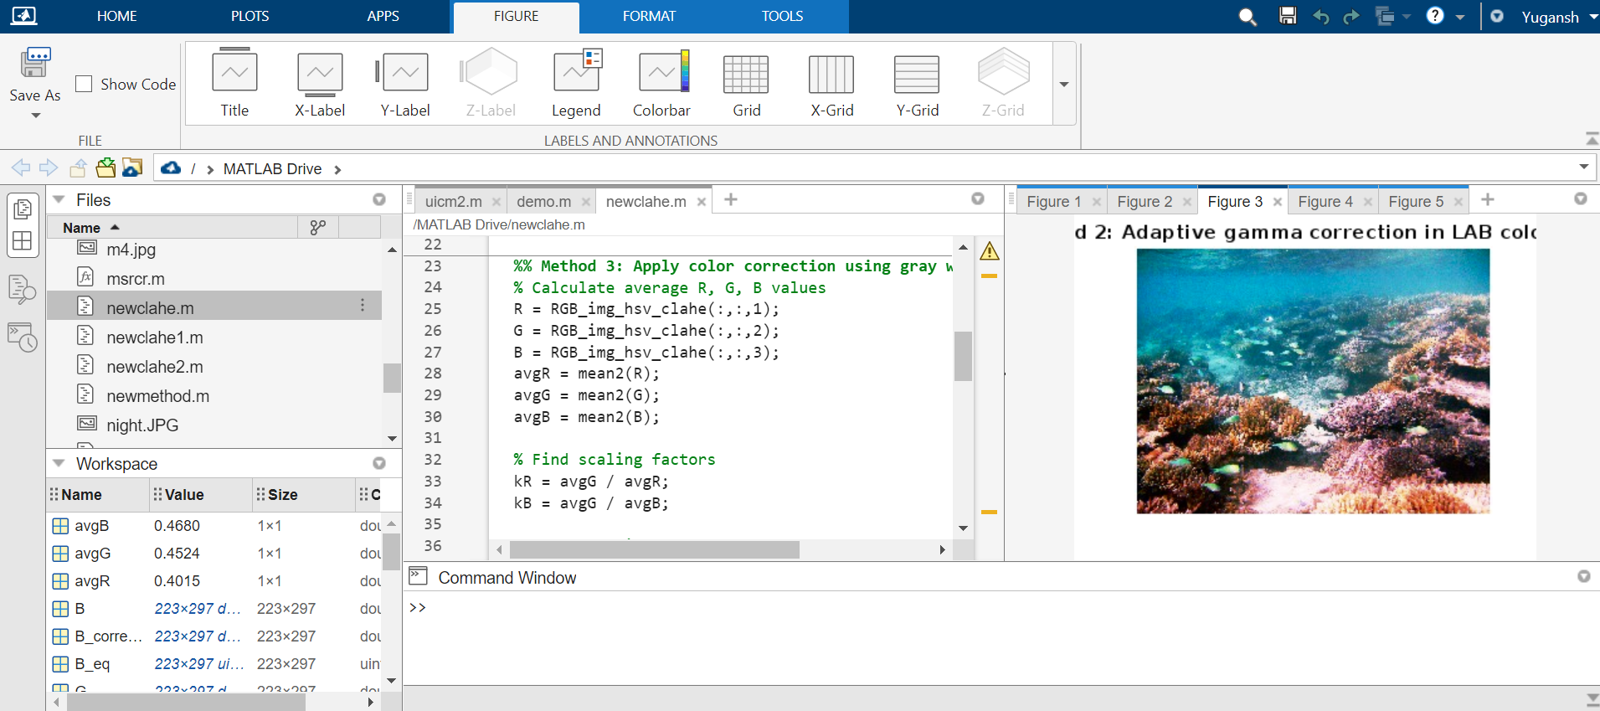
Method 2: Adaptive gamma correction in LAB color space

Slide 28
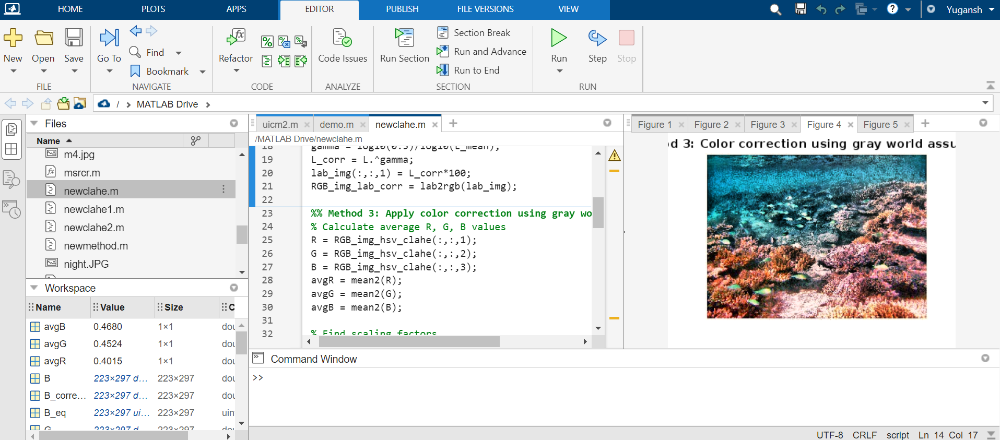
Method 3: Color correction using gray world assumption

Slide 29
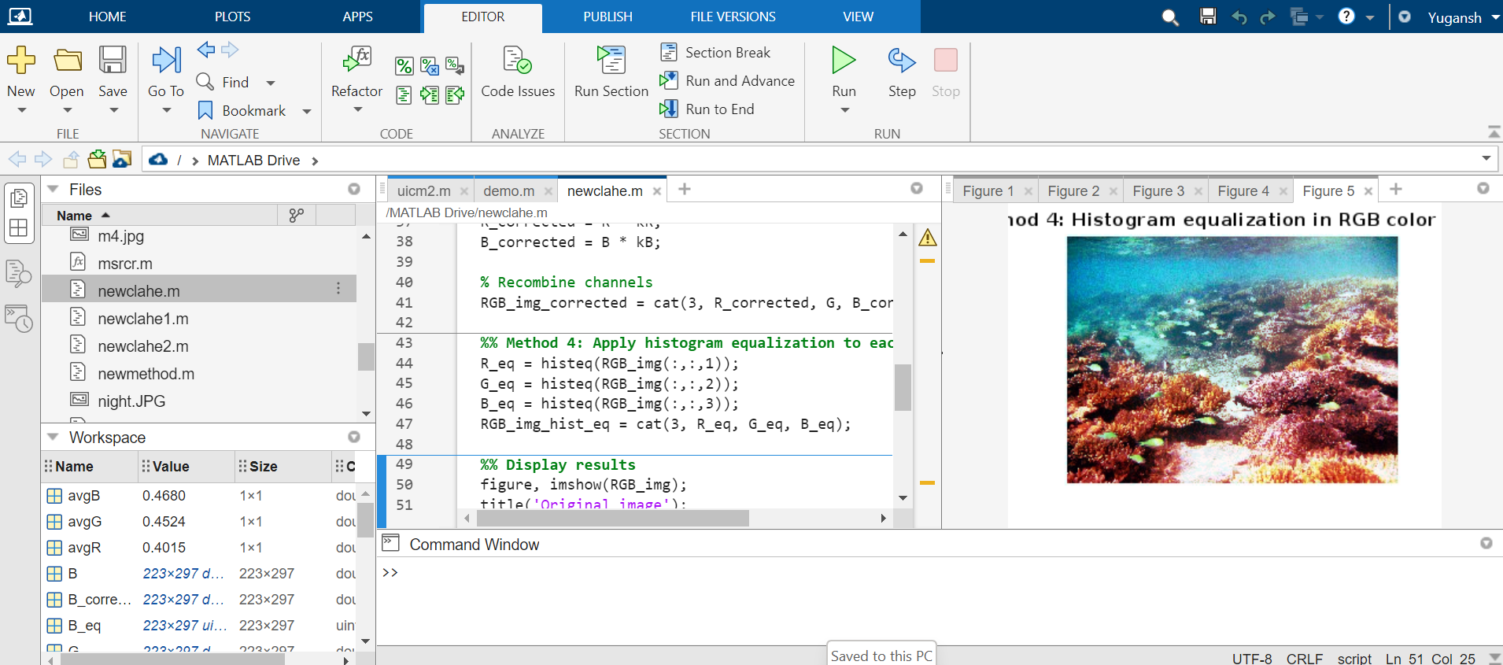
Method 4: Histogram equalization in RGB color space

Slide 30
Result and Discussion
Underwater Image Metric :
The metric is composed of independent measurements:
Underwater Image Colorfulness Measure (UICM),
Underwater Image Sharpness Measure (UISM),

Slide 31
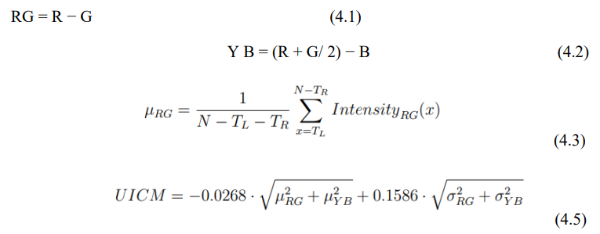
UICM

Slide 32
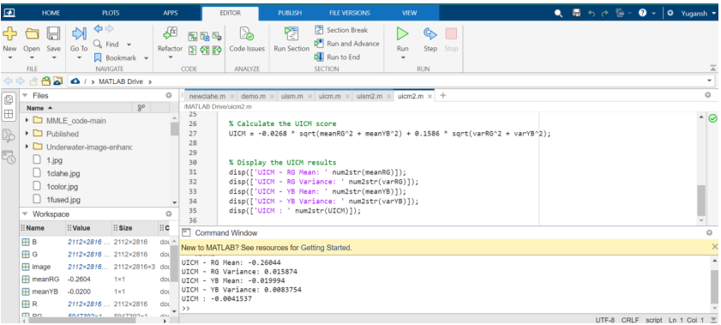
Original Image UICM score with mean and variance.

Slide 33
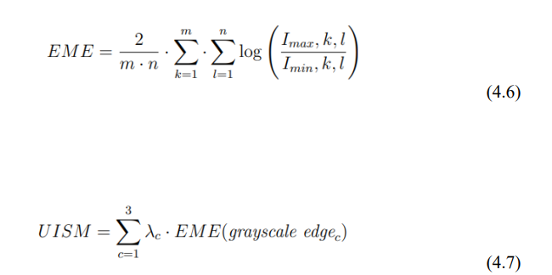
UISM

Slide 34
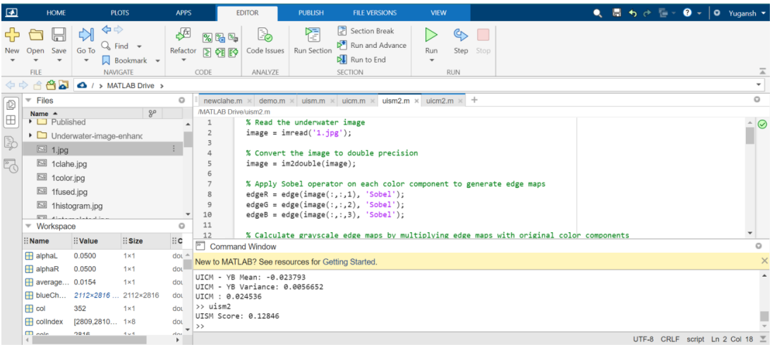
Original and repaired images from UISM

Slide 35
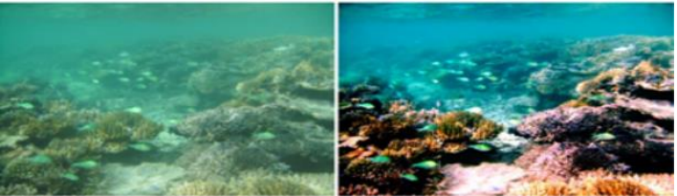
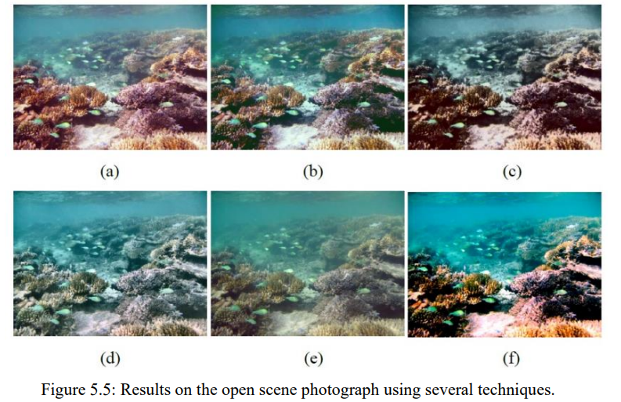
Final results :

Slide 36
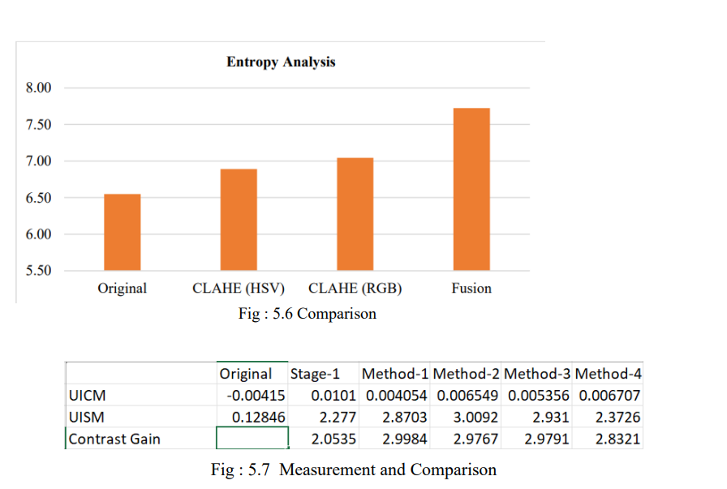
Entropy analysis and Contrast Gain

Slide 37
Conclusion :
Different underwater image enhancement techniques are reviewed and studied. All the reviewed methods enhance the underwater images to great extent. The issue of the uneven light illumination is likewise disregarded by the vast majority of the scientists.
Through a multi-stage fusion process, the enhanced Reflective component and the dehazed Illuminance component are combined to generate a single output image. The technique effectively enhances color balance and reduces haziness, resulting in visually appealing and clearer underwater images.
The results of the experiments show that the suggested method of enhancing underwater photographs by using a single input image and applying specialised processing to several components is effective. This method offers a potentially effective way to enhance the clarity and visual appeal of underwater photos

Slide 38
References :
Hitam, M. S., W. N. J. H. W. Yussof, E. A. Awalludin, and Z. Bachok. "Mixture contrast limited adaptive histogram equalization for underwater image enhancement."IEEE, 2013.
Sowmyashree M. S., Sukrita K. Bekal, R. Sneha, and N. Priyanka. "A Survey on the various underwater image enhancement techniques." International Journal of Engineering Science Invention, 2014.
Aysun Tasyapı Celebi and Sarp Erturk. “Visual enhancement of underwater images using Empirical Mode Decomposition” Elsevier , 2011
Dr.G.Padmavathi, Dr.P.Subashini, Mr.M.Muthu Kumar and Suresh Kumar Thakur. “Comparison of Filters used for Underwater Image Pre-Processing” IJCSNS , 2010.
. Setiawan, Agung W., Tati R. Mengko, Oerip S. Santoso, and Andriyan B. Suksmono. "Color Retinal Image Enhancement using CLAHE." International Conference on ICT for Smart Society (ICISS), 2013.
Khan, Mohd Farhan, Ekram Khan, and Z. A. Abbasi. “Multi segment histogram equalization for brightness preserving contrast enhancement.”Springer Berlin Heidelberg, 2012.

